Slide 1
Empirical Likelihood
Dario Nappa
Jon Sanders

Slide 2
What we are going to talk about
Parametric Likelihood
Empirical likelihood
Empirical Likelihood Statistical properties
Pseudo Empirical Likelihood
Use of auxiliary information
Comparison with other statistical confidence intervals
Application 1: Wu and Rao 2004
Application 2: Chen and Quin 1993
Available Packages
Bibliography

Slide 3
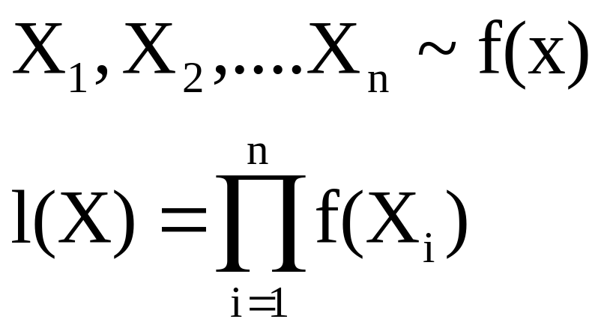
Parametric Likelihood
Parametric likelihood for a set of n independent observations
density

Slide 4
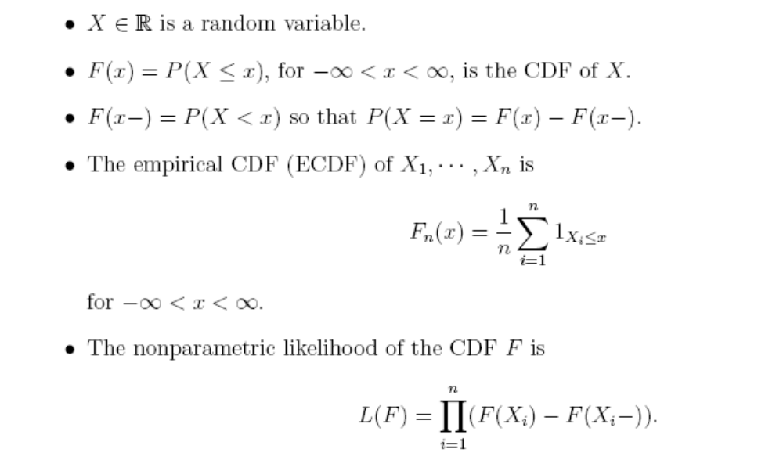

Empirical Likelihood

Slide 5
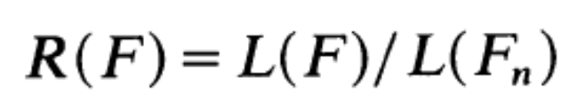
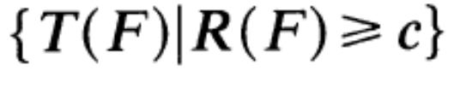
Statistical Properties
We can define a likelihood ratio
Under some reasonable conditions sets of the form
Can be used as confidence region for T(F₀)
MLE

Slide 6
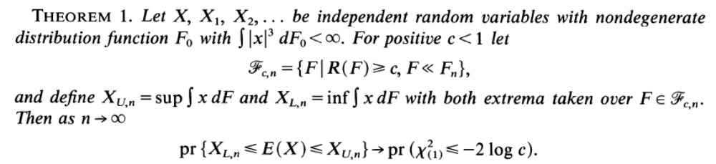
Owen 1988

Slide 7
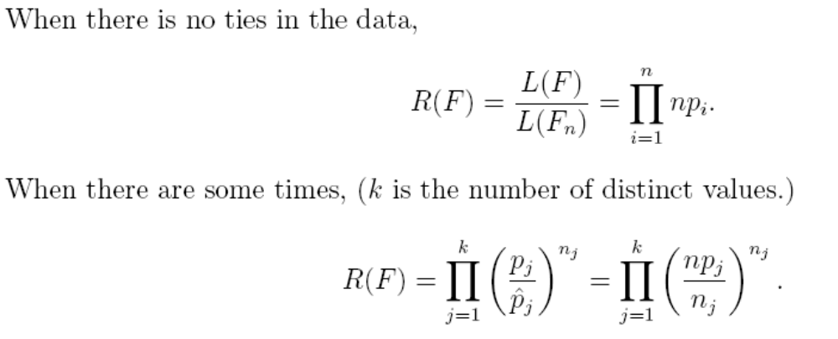
Likelihood Ratio

Slide 8
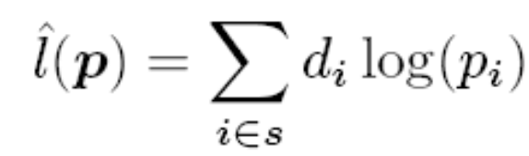
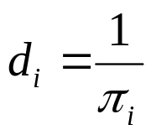

Pseudo Empirical
1 Use Horvitz-Thompson estimator for the empirical log-likelihood
2 Defined as pseudo empirical likelihood
3. Once again the likelihood ratio follows a Chi-square distribution

Slide 9


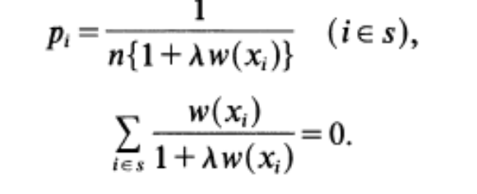
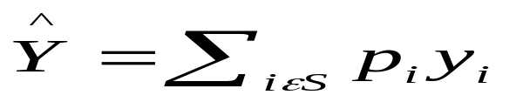
Auxiliary information
1. We have to maximize the EL
2. Using the auxiliary information
3. Subject to the constrains
4. Solution
Note In this slide X is the auxiliary information, Y is the entity of interest

Slide 10
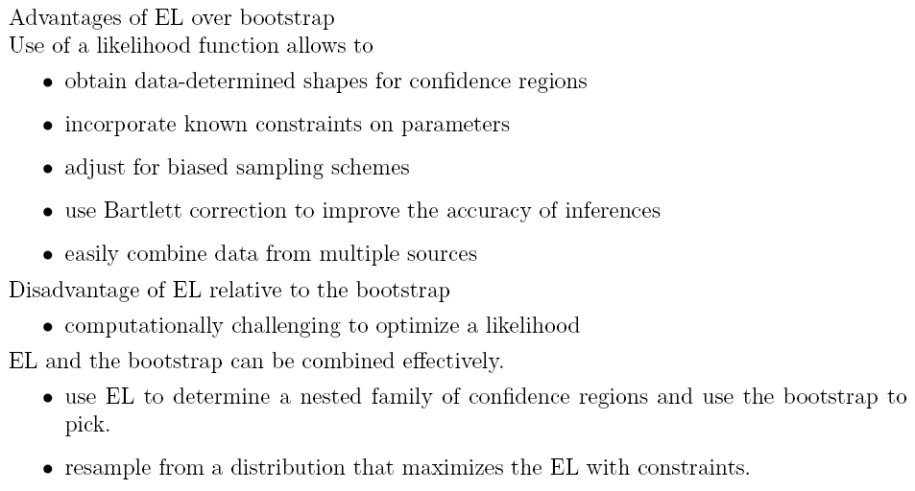
Comparison with other statistical confidence intervals
Parametric Method
Bootstrap

Slide 11
Applications

Slide 12
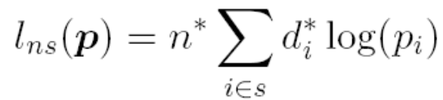
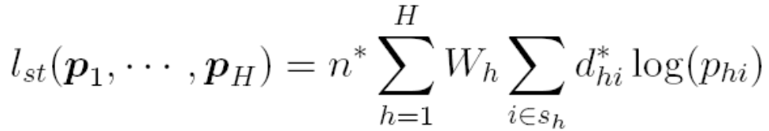
Application 1: Wu and Rao (2004)
Create confidence intervals for complex sampling designs
Use Pseudo Empirical Likelihood:
Authors show asymptotic results similar to empirical likelihood

Slide 13
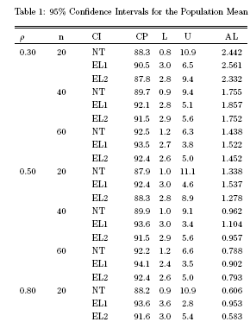

Coverage probability
Tails Error Rates
Average Length
NT: Normality Test
EL1: Empirical Likelihood
EL2: Empirical Likelihood with mean constrain
EL has coverage probability closer to the nominal value
The error rates are more symmetrical for the EL
EL2 has shorter length, worse coverage probability than L1

Slide 14
Application 2: Chen and Qin (1993)
Interested in efficient use of auxiliary information
Derive results involving auxiliary data seen earlier
Simulation comparing MELE to ratio estimators

Slide 15
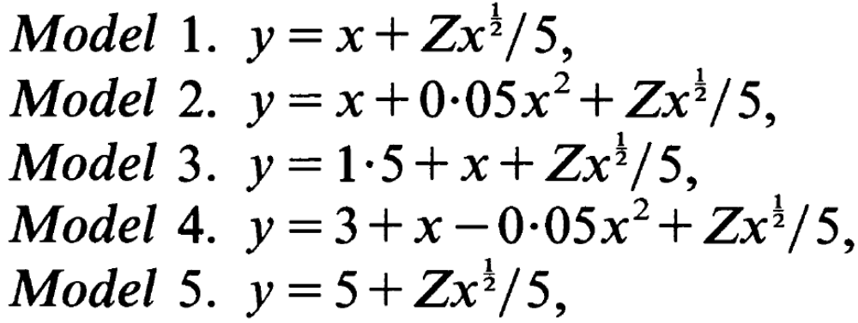
Models Used

Slide 16
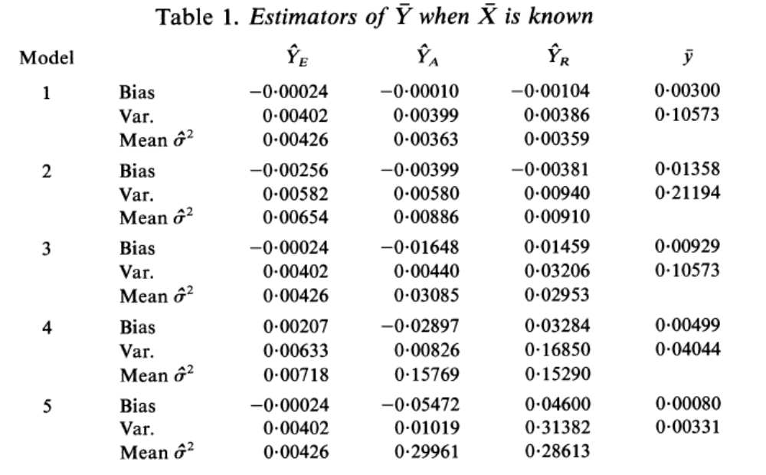
Results

Slide 17
Available Packages
el.S
  S-Plus function for calculating ELR for mean
  http://www-stat.stanford.edu/~owen/empirical/el.S
emplik
  R package for EL
  CRAN Mirror or http://www.ms.uky.edu/~mai/splus/library/emplik/
elm.m/plog.m
  ELR and PELR functions in Matlab
  http://www-stat.stanford.edu/~owen/empirical/elm.m
  http://www-stat.stanford.edu/~owen/empirical/plog.m
GAUSS
  http://www.ssc.wisc.edu/~bhansen/progs/progs_gmm.html

Slide 18

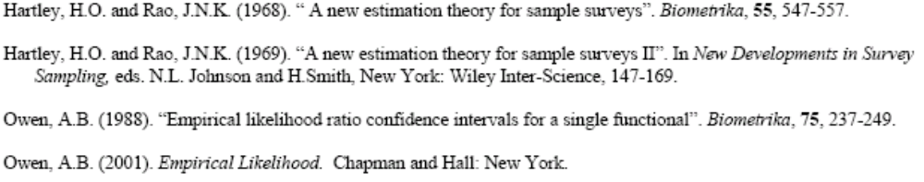
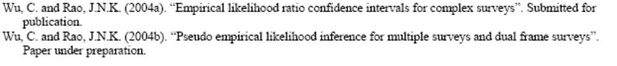

Bibliography

